Slide 1
Heart Disease Prediction Using Machine Learning

Slide 2
TEAM MEMBERS
S MOHESHWARAN-20BCB4022
K PRIYADHARSAN-20BCB4030
S S RAAJGANESH-20BCB4031

Slide 3

INTRODUCTION
According to the World Health Organization, every year 12 million deaths occur worldwide due to Heart Disease.
The early diagnosis of heart disease plays a vital role in making decisions on lifestyle changes in high-risk patients and in turn reduces the complications.
Machine learning proves to be effective in assisting in making decisions and predictions from the large quantity of data produced by the health care industry. This project aims to predict future Heart Disease by analyzing data of patients which classifies whether they have heart disease or not using machine-learning algorithm.
By collecting the data from various sources, classifying them under suitable headings & finally analysing to extract the desired data we can say that this technique can be very well adapted to do the prediction of heart disease.

Slide 4
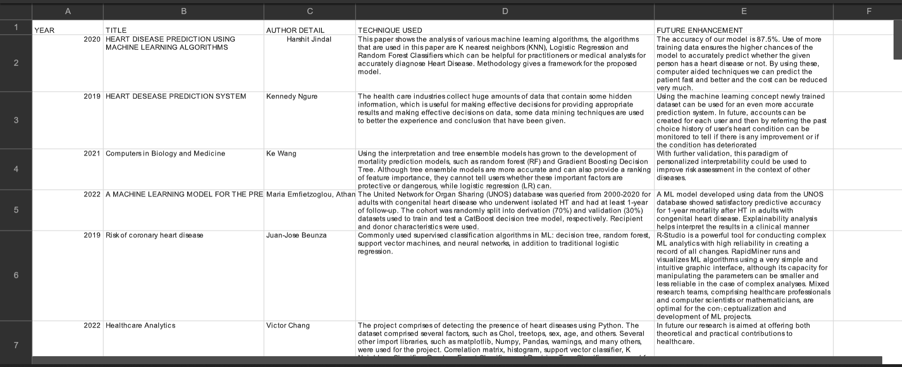
LITERATURE REVIEW

Slide 5
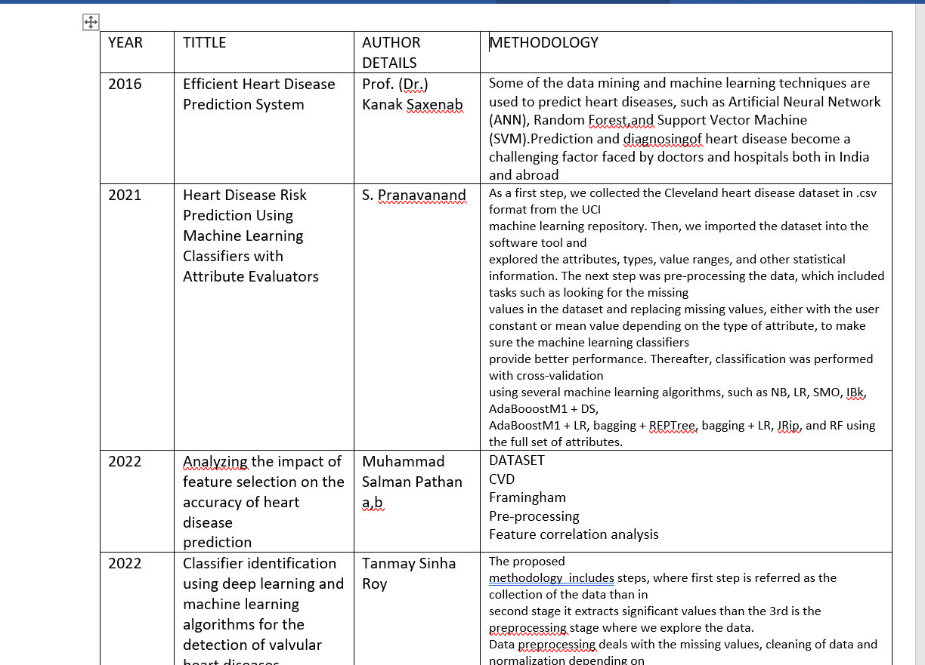

Slide 6
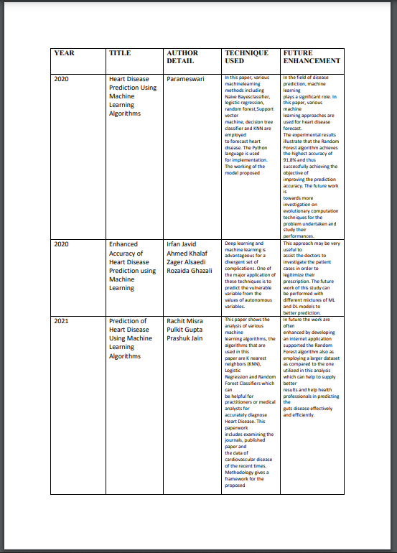

Slide 7
PROBLEM STATEMENT
The major challenge in heart disease is its detection. There are instruments available which can predict heart disease but either it are expensive or are not efficient to calculate chance of heart disease in human. Early detection of cardiac diseases can decrease the mortality rate and overall complications. However, it is not possible to monitor patients everyday in all cases accurately and consultation of a patient for 24 hours by a doctor is not available since it requires more sapience, time and expertise. Since we have a good amount of data in today’s world, we can use various machine learning algorithms to analyze the data for hidden patterns. The hidden patterns can be used for health diagnosis in medicinal data.

Slide 8
ABSTRACT
Machine Learning is used across many ranges around the world. Machine Learning can play an Essential role in predicting presence/absence of locomotors disorders, Heart diseases and more. Such information, if predicted well in advance, can provide important intuitions to doctors who can Then adapt their diagnosis and dealing per patient basis. We work on predicting possible Heart Diseases in people using Machine Learning algorithms. In this project we perform the comparative Analysis of classifiers like decision tree, Naïve Bayes, Logistic Regression, SVM and Random Forest And we propose an ensemble classifier which perform hybrid classification by taking strong and Weak classifiers

Slide 9
OBJECTIVE
Heart disease is even being highlighted as a silent killer which leads to the death of a person without obvious symptoms. The nature of the disease is the cause of growing anxiety about the disease & its consequences. Hence continued efforts are being done to predict the possibility of this deadly disease in prior. So that various tools & techniques are regularly being experimented with to suit the present-day health needs. Machine Learning techniques can be a boon in this regard. Even though heart disease can occur in different forms, there is a common set of core risk factors that Influence whether someone will ultimately be at risk for heart disease or not. By collecting the data from various sources, classifying them under suitable headings & finally analysing to extract the desired data we can conclude. This technique can be very well adapted to the do the prediction of heart disease. As the well-known quote says “Prevention is better than cure”, early prediction & its control can be helpful to prevent & decrease the death rates due to heart disease.

Slide 10
SYSTEM ARCHITECTURE
The working of this system is described as follows:
Dataset collection is collecting data which contains patient details. Attributes selection process selects the useful attributes for the prediction of heart disease. After identifying the available data resources, they are further selected, cleaned, made into the desired form. Different classification techniques as stated will be applied on preprocessed data to predict the accuracy of heart disease. Accuracy measure compares the accuracy of different classifiers.

Slide 11
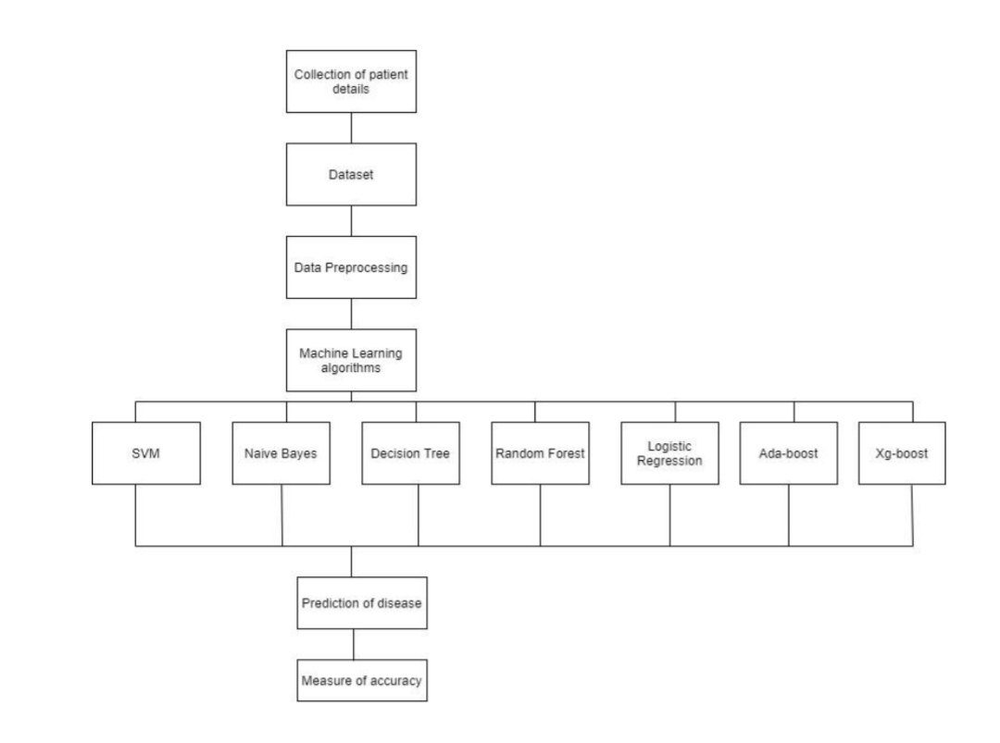

Slide 12
LIST OF REFERENCES
[1] Soni J, Ansari U, Sharma D & Soni S (2011). Predictive data mining for medical diagnosis: an overview of heart disease prediction. International Journal of Computer Applications, 17(8), 43-8
[2] Dangare C S & Apte S S (2012). Improved study of heart disease prediction system using data mining classification techniques. International Journal of Computer Applications, 47(10), 44-8.
[3] Ordonez C (2006). Association rule discovery with the train and test approach for heart disease prediction. IEEE Transactions on Information Technology in Biomedicine, 10(2), 334-43.
[4] Shinde R, Arjun S, Patil P & Waghmare J (2015). An intelligent heart disease prediction system using k-means clustering and Naïve Bayes algorithm. International Journal of Computer Science and Information Technologies, 6(1), 637-9.

Slide 13
[5] Bashir S, Qamar U & Javed M Y (2014, November). An ensemble-based decision support framework for intelligent heart disease diagnosis. In International Conference on Information Society (i-Society 2014) (pp. 259-64). IEEE. ICCRDA 2020 IOP Conf. Series: Materials Science and Engineering 1022 (2021) 012072 IOP Publishing doi:10.1088/1757-899X/1022/1/012072 9
[6] Jee S H, Jang Y, Oh D J, Oh B H, Lee S H, Park S W & Yun Y D (2014). A coronary heart disease prediction model: the Korean Heart Study. BMJ open, 4(5), e005025.
[7] Ganna A, Magnusson P K, Pedersen N L, de Faire U, Reilly M, Ärnlöv J & Ingelsson E (2013). Multilocus genetic risk scores for coronary heart disease prediction. Arteriosclerosis, thrombosis, and vascular biology, 33(9), 2267-72.
[8] Jabbar M A, Deekshatulu B L & Chandra P (2013, March). Heart disease prediction using lazy associative classification. In 2013 International Mutli-Conference on Automation, Computing,Communication, Control and Compressed Sensing (iMac4s) (pp. 40- 6). IEEE.
[9] Brown N, Young T, Gray D, Skene A M & Hampton J R (1997). Inpatient deaths from acute myocardial infarction, 1982-92: analysis of data in the Nottingham heart attack register. BMJ, 315(7101), 159-64.
[10] Folsom A R, Prineas R J, Kaye S A & Soler J T (1989). Body fat distribution and self-reported prevalence of hypertension, heart attack, and other heart disease in older women. International journal of epidemiologyy, 18(2), 361-7.

Slide 14
THANK YOU

